Slide 1
AI CHATBOT
FOR UNIVERSITY STUDENT SERVICE

Slide 2
Group Members:
Fahad Yaseen
Adeel Ahmad Kidwai

Slide 3
Introduction:
The AI chatbot service is a digital tool designed to provide personalized support and assistance to university students. The service aims to improve student engagement, reduce administrative workload, and enhance the overall student experience. In this presentation, we will discuss the development, implementation, and evaluation of the AI chatbot service for university students.

Slide 4
Methodology
The AI chatbot service was developed using natural language processing (NLP) and machine learning (ML) technologies. The development team worked closely with university staff and students to identify user needs and refine the service's features and capabilities. It collected a limited range of data, including user queries. Chatbot is designed to be user-friendly and easy to use, with a simple and intuitive interface.

Slide 5
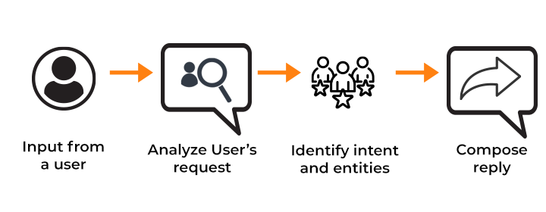

Slide 6
Results:
The AI chatbot service is evaluated based on a range of performance metrics, including user satisfaction and response time. The service received marks for user satisfaction and was found to be effective at providing support to students.

Slide 7
Conclusion:
The AI chatbot service has the potential to revolutionize the way universities and colleges provide support and assistance to their students. The service can help to free up staff time, improve the quality of support provided to students, and enhance the overall student experience.

